Slide 1



BSCCS-GROUP_01

Slide 2

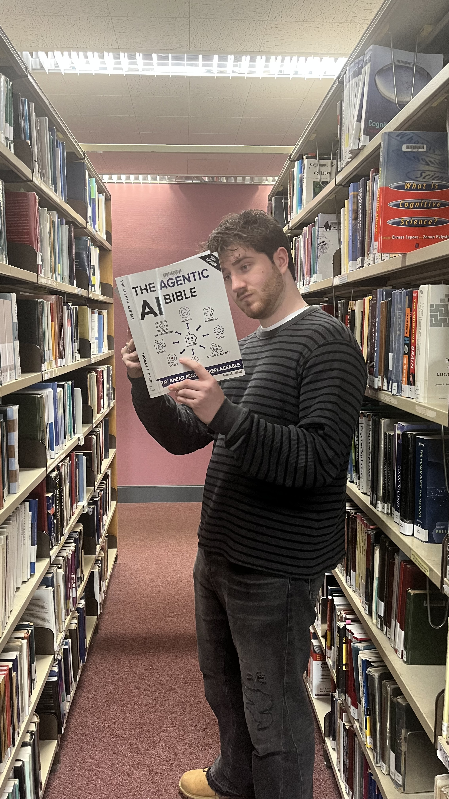
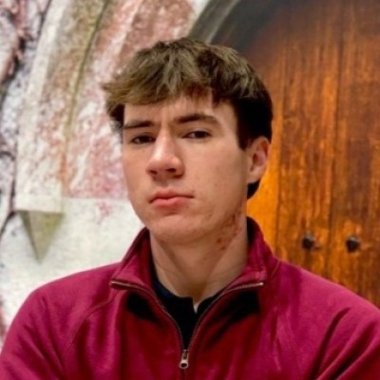

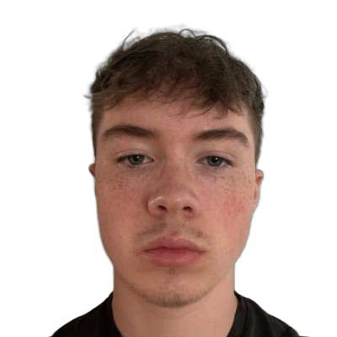
INTRODUCTION
The Team & App Choice
Jake Sparks
Mikolaj Wujek
Stephen Landers
JJ Russell
Data Analyst
Interactive Designer & Manager
UI Designer
Developer
Why did we choose the Canvas app?
We personally experienced issues while using Canvas that we wanted to address.
The Canvas app is relevant to our daily academic tasks.
Canvas is widely used by students, which makes gathering meaningful data easy.

Slide 3
METHODS AND PROCESS OVERVIEW
Data Collection & Synthesis
20 participants
Mixed-method evaluation
Semi-structured interviews
Affinity Diagramming
Theme identification
UEQ-S | NASA-TLX | PSSUQ
(Clustering insights into themes)
Findings were shared with designers to inform redesign

Slide 4
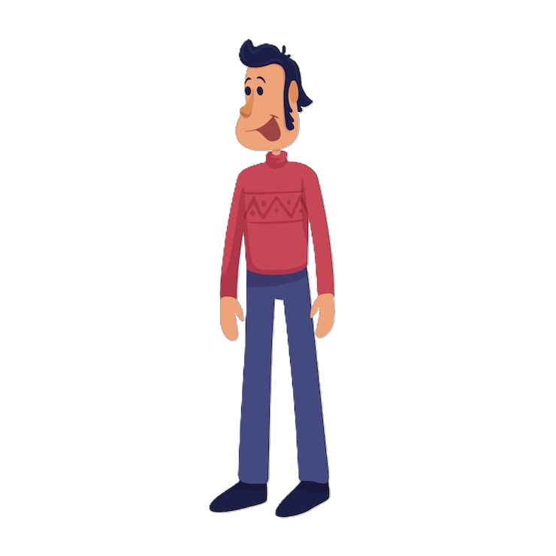
METHODS AND PROCESS OVERVIEW
Primary Persona
Goals
Behaviours
Frustrations
Submit assignments quickly & confidently
Access lecture materials easily
Stay organised
Know what tasks are coming up next
Checks app daily
Switches between modules frequently.
Uses external tools (calendar, notes)
Hard to find assignments.
Confusing module layouts.
Doesn't trust submissions.
Hard to tell when things are due.
Cannot use the dyslexic font on mobile
John Doe Russolo
Age: 21
Gender: Male
Occupation: Student (Law)
Location: Cork, Ireland
Tech Skill Level: Medium
Smartphone: iPhone 15
Key Quotes
"I just want to quickly find my assignments without wasting time searching"
“The to-do list feels unreliable”

Slide 5
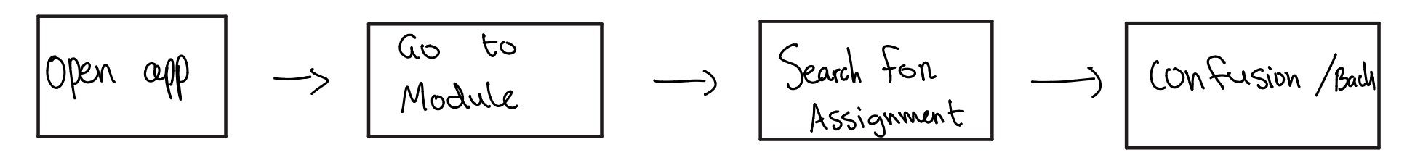
METHODS AND PROCESS OVERVIEW
From Insights to Design Requirements
Persona
Storyboarding
Hierarchical Task Analysis
Design Requirements
Storyboarding
Hierarchical Task Analysis
User journey visualization
Identified pain points
e.g. difficulty finding assignments
Task breakdown
Identified inefficiencies
Too many steps
Design Requirements
Reduce navigation steps
Improve assignment visibility
Simplify workflows
Used to identify inefficiencies and reduce cognitive load

Slide 6
METHODS AND PROCESS OVERVIEW
Prioritisation Framework (MoSCoW)
Must Have
Should Have
Could Have
Won't Have
Search bar
Urgent task warning
Consistent module layout
Submission confirmation
Grades tab
To-Do list task grouping
Grades summary
Task status badges
Dyslexia-friendly font
Clear Return Navigation
Dark / light mode toggle
Module progress bar
Recent submissions quick access
Calendar sync with 3rd party apps
Offline mode
Prioritised based on frequency of use, usability impact, and cognitive load.

Slide 7
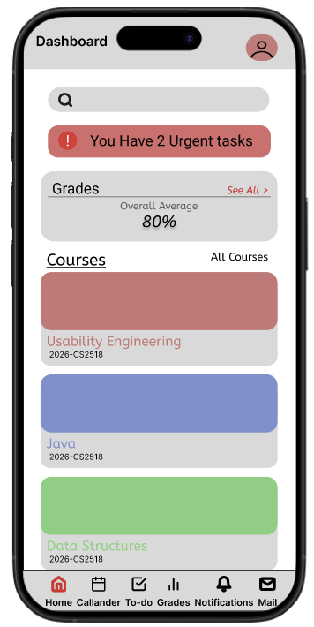
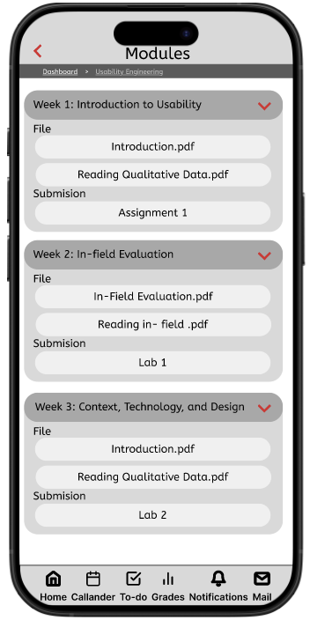
PROPOSED DESIGN
Navigation & Dashboard
Search Bar
Users can search for files, modules, labs etc. from the Dashboard.
Urgent Task Warning
Displays a red banner if there are tasks due within 24hrs.
Grades Summary Card
Shows the overall grade based on the module grades.
Consistent Module Layout
All modules have the same layout to reduce confusing navigation.

Slide 8
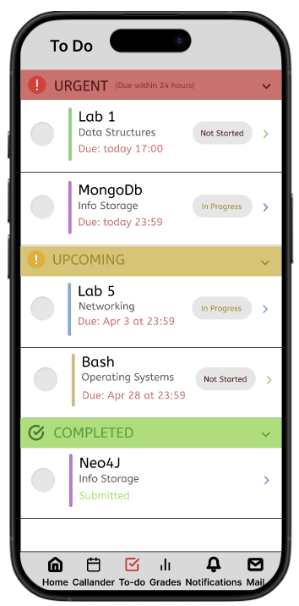
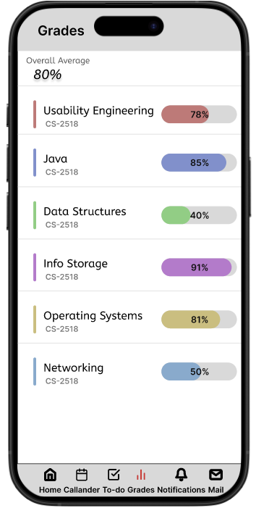
PROPOSED DESIGN
To-Do & Grades Tab
Priority Grouping (To-Do)
To-Do list tasks are grouped into Urgent / Upcoming / Completed.
Status Badges
Each task has a Not Started / In Progress / Submitted / Late.
New Grades Tab
Centralised tab displaying grades for individual & overall grades.

Slide 9
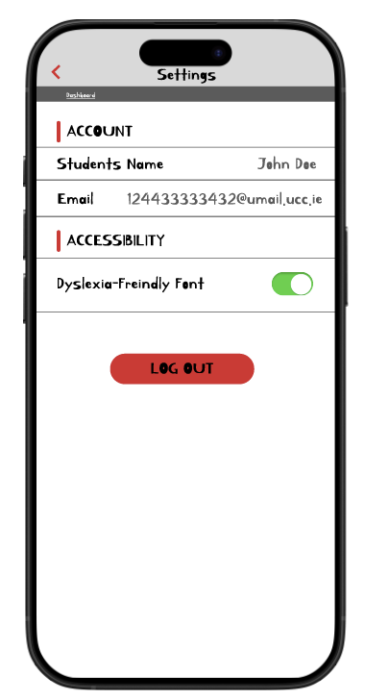
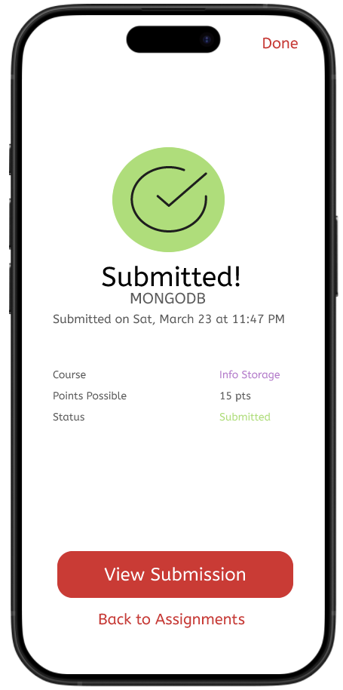
PROPOSED DESIGN
Accessibility & UX Improvements
Dyslexia Friendly Font
Toggle button in Settings to enable ​Dyslexia-Friendly font.
Submission Confirmation
Clearly visible successful submission, along with a timestamp.

Slide 10
PROPOSED DESIGN
How the Design Meets the Needs of the Persona
1. Easier to Find Assignments ✅
Frustrations
Urgent tasks are shown in the dashboard for quick recognition.
I'm so glad these issues were cleared up!
Hard to find assignments.
Confusing module layouts.
Doesn't trust submissions.
Unclear when things are due.
Cannot use the dyslexic font on mobile.
2. Standardised Module Layouts ✅
Every module has the same layout to reduce confusion.
3. Clear Submission Screen ✅
A large checkmark clearly indicates to the user it was successful .
4. Intuitive Submission Deadlines ✅
To-Do list groups tasks based on urgency.
5. Dyslexic font added ✅
Toggle button in Settings to enable ​Dyslexia-Friendly font.

Slide 11
JOURNEY AS A TEAM
Role Contributions & Conflict Resolutions
Jake – Data Analyst
Mikolaj – Interactive Designer
Stephen – UI Designer
JJ – Developer
Gathered all data, cross referenced insights, found and informed the team of changes to be made.
Collaborated with Interactive & UI Designers to ensure the designs lined up with user data.
Designed how users navigate trough the app, developed sketches to outline the app's structure and layout. Colaborated with UI designer to ensure interaction designs compliment the apps visuals.
Worked on colour schemes, fonts and layout, designed consistent app buttons and icons, worked with the ID and DA to ensure designs meet design requirements, worked with the developer to integrate design.
Created a prototype mimicking Canvas, developed buttons & icons, implemented new features by working closely with UID and ID while also working with DA to ensure design requirements were met. Figured out the technical feasibility of designs
Conflict Resolutions
Conflict
Our Data Analyst lives away from Cork, and we found it difficult to arrange meet-ups.
Resolution
We organized Zoom calls when we could not meet up in person.
Conflict
We had disputes on where things should go within the PowerPoint and the prototype.
Resolution
We heard each other out in a democratic setting and chose the best option that suited all of us.

Slide 12
LESSONS LEARNED
Most Important Lessons
We learned that clear communication early on is very beneficial and helps with keeping a steady workflow.
Sharing responsibility improved teamwork and ensured we reached deadlines on time.
We learned that getting different perspectives from team members was highly important before starting any task.
How this group experience will influence future projects:
We will ensure that we agree on goals before starting any tasks.​
We will value user feedback over personal opinions.​
We will contribute consistently from the start to avoid last minute issues.

Slide 13
Q&A SESSION
Any Questions?

